Slide 1

Felucca
A Control Center for Pharos Tools
Team BugHunter
Di Mu, Guancheng Li, Sudi Lyu, Zihao Zhou

Slide 2

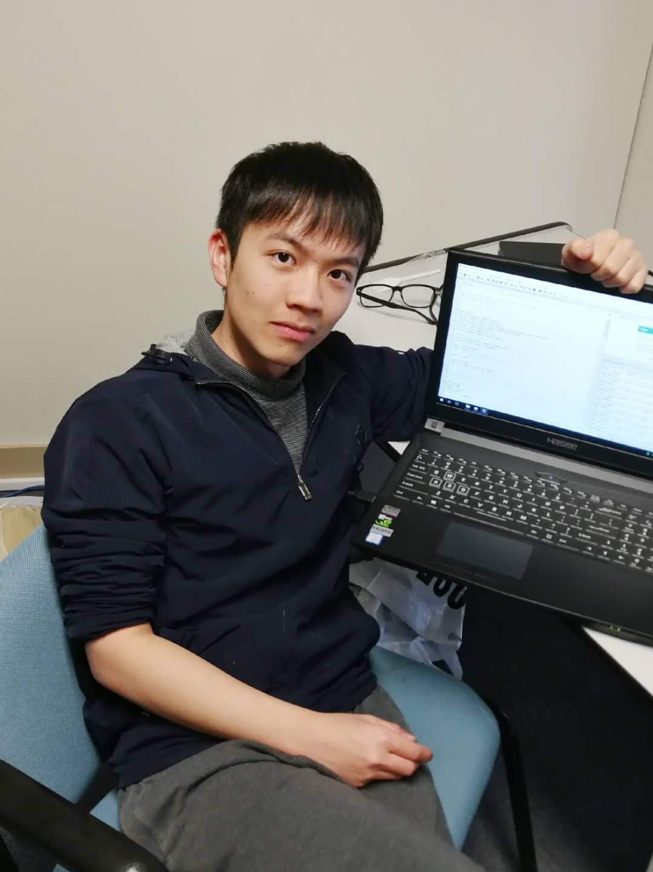




MITS - BugHunter
Team Members
Client
Mentor
Guancheng Li
Zihao Zhou
Jeffrey Gennari
Hasan Yasar
Sudi Lyu
Di Mu
Notes:
1. Put your team name at the top. Please include the program
2. Please put pictures of your team on the right side of the slide roughly as show. Include your mentor or mentors. Resize as necessary to make everything fit. Please keep 20/18 point font for names.
3. Include a project description on the left side of the slide. Please keep the font at 20 point for the description. Feel free to include graphics if you like. Include who your sponsor is.
0:15

Slide 3
Outline
Project Context
Requirements Management
Architecture Design
Techical Stack
Project Planning
Project Tracking
Quality Management
Configuration Management
Risk Management
Reflection
Notes:
Project Context 2
Requirements Management 3.5
Architecture Design 3
Techical Stack 1
Project Planning 3
Project Tracking 3
Quality Management 3
Configuration Management 2
Risk Management 2
Reflection

Slide 4
Project Context
Notes:
0:21

Slide 5
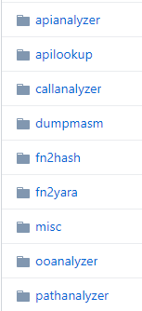
Project Context
Pharos
A set of tools, supporting Program Analysis and Reverse Engineering
Developed and maintained by the CERT team
Tools are hard to operate, and individual tools do not integrate well together
Notes:
0:40

Slide 6
Project Context
Pharos
A set of tools, supporting Program Analysis and Reverse Engineering
Developed and maintained by the CERT team
Tools are hard to operate, and individual tools do not integrate well together
Felucca
A Control Center for Pharos tools
Aiming to improve both Integrity and Usability of Pharos
Use can submit jobs and retrieve the results after execution
Support complex jobs with multiple tasks and pipelined-execution
Execution result and history can be well-organized
Our project
Notes:
1:06

Slide 7

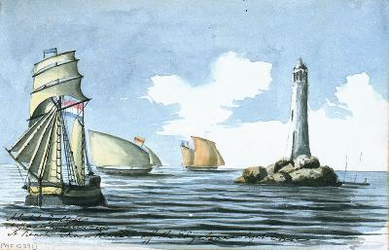
Why do we use “Felucca” as the name?
“Pharos“ means...
“Felucca” means...
Notes:
ancient lighthouse and sailing boat in the eastern Mediterranean
1:20

Slide 8
Requirements
Management
Notes:
01:28

Slide 9
Requirement - Glossary
Binary: An executable file needed to be analyzed using tools. It is the input of tools
Tool: A program which takes a binary file with arguments as input and then generates several analysis outputs. It could be from Pharos toolset or customized tools from users
Pharos Toolset: The original Pharos tools provided by developers
Customized tools: A customized tool provided by users
Notes:
01:55

Slide 10
Requirement - Glossary (Cont.)
Task: A task is an execution of a single tool with a single binary executable.
Job: A job is a collection of tasks. Tasks in jobs need to be executed by some pattern determined by their relationships. A job is finished only if all the tasks are finished in a good manner.
Three kinds of outputs from tools:
Log: The log file generated by tools, the inner information of execution
Output(file): The output file generated by tools, outcome of execution
Command line output: The output of standard output of tools, explicit information of execution
Notes:
2:28

Slide 11
Requirement - User Analysis
There are three kinds of users.
All of them will use Felucca to execute Pharos tools.
Analysts have security concerns, and thus may run Pharos without Internet. Not interested in the source code of Pharos.
Researchers care less about security. Besides, they would like to test their own tools, while they can’t modify Pharos tools.
Developers can update Pharos tools to the newest version. They can update the Pharos Toolset.
Notes:
03:03

Slide 12
Requirement - Requirements Analysis
Non-functional requirements:
Isolation: As the binary files could be malicious, it is important to protect the host OS by isolating the analysis process. We decide to use Docker to achieve this.
Absence of Internet Access: Analysts may use Felucca on their devices without Internet access. To meet their requirements, Felucca must support the offline mode and offline updates of Pharos Toolset.
Access Control: Developers can update the Pharos toolset while researchers could only modify their own tools. Analyst won’t touch the source code of the tools.
Notes:
03:55

Slide 13
Requirement - Requirements Analysis
Three deployment modes should be supported:
Single-user offline mode: Felucca runs on a device without Internet access. Only the owner could use it.
Multi-user offline mode: Felucca runs on a machine, which acts as a server in a private LAN. All users in the same LAN could use it by visiting the web page.
Online mode: Felucca runs on an Internet server. Everyone could use Felucca by visiting the web page. Account mechanism is needed for access control.
Notes:
04:40

Slide 14
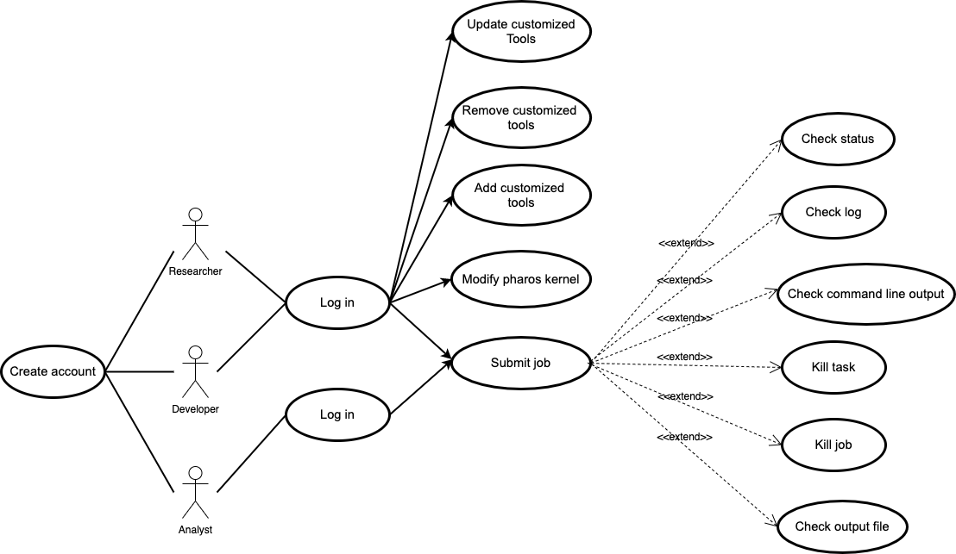
Requirement - Use cases
3 kinds of users
13 use cases
Use case diagram
Notes:
05:13

Slide 15
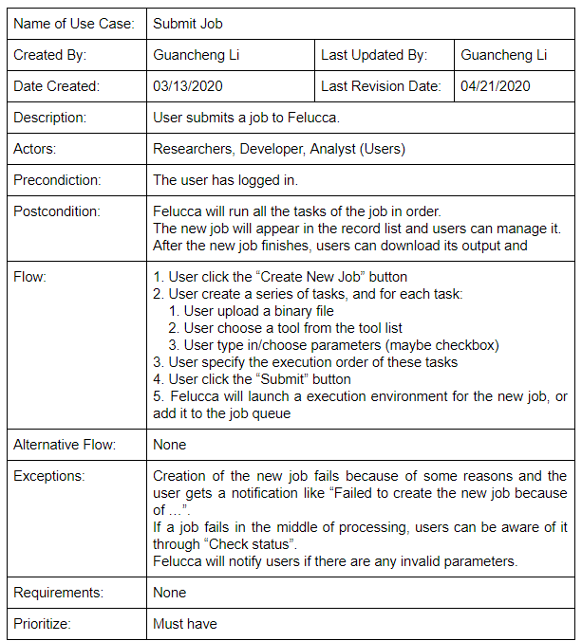
Requirement - Use case format
Include all related information
Easier to break them down into functions
Notes:
05:29
All the use case will be in the google drive, this is example ,detailed information

Slide 16
Architecture
Design
Notes:
05:36

Slide 17
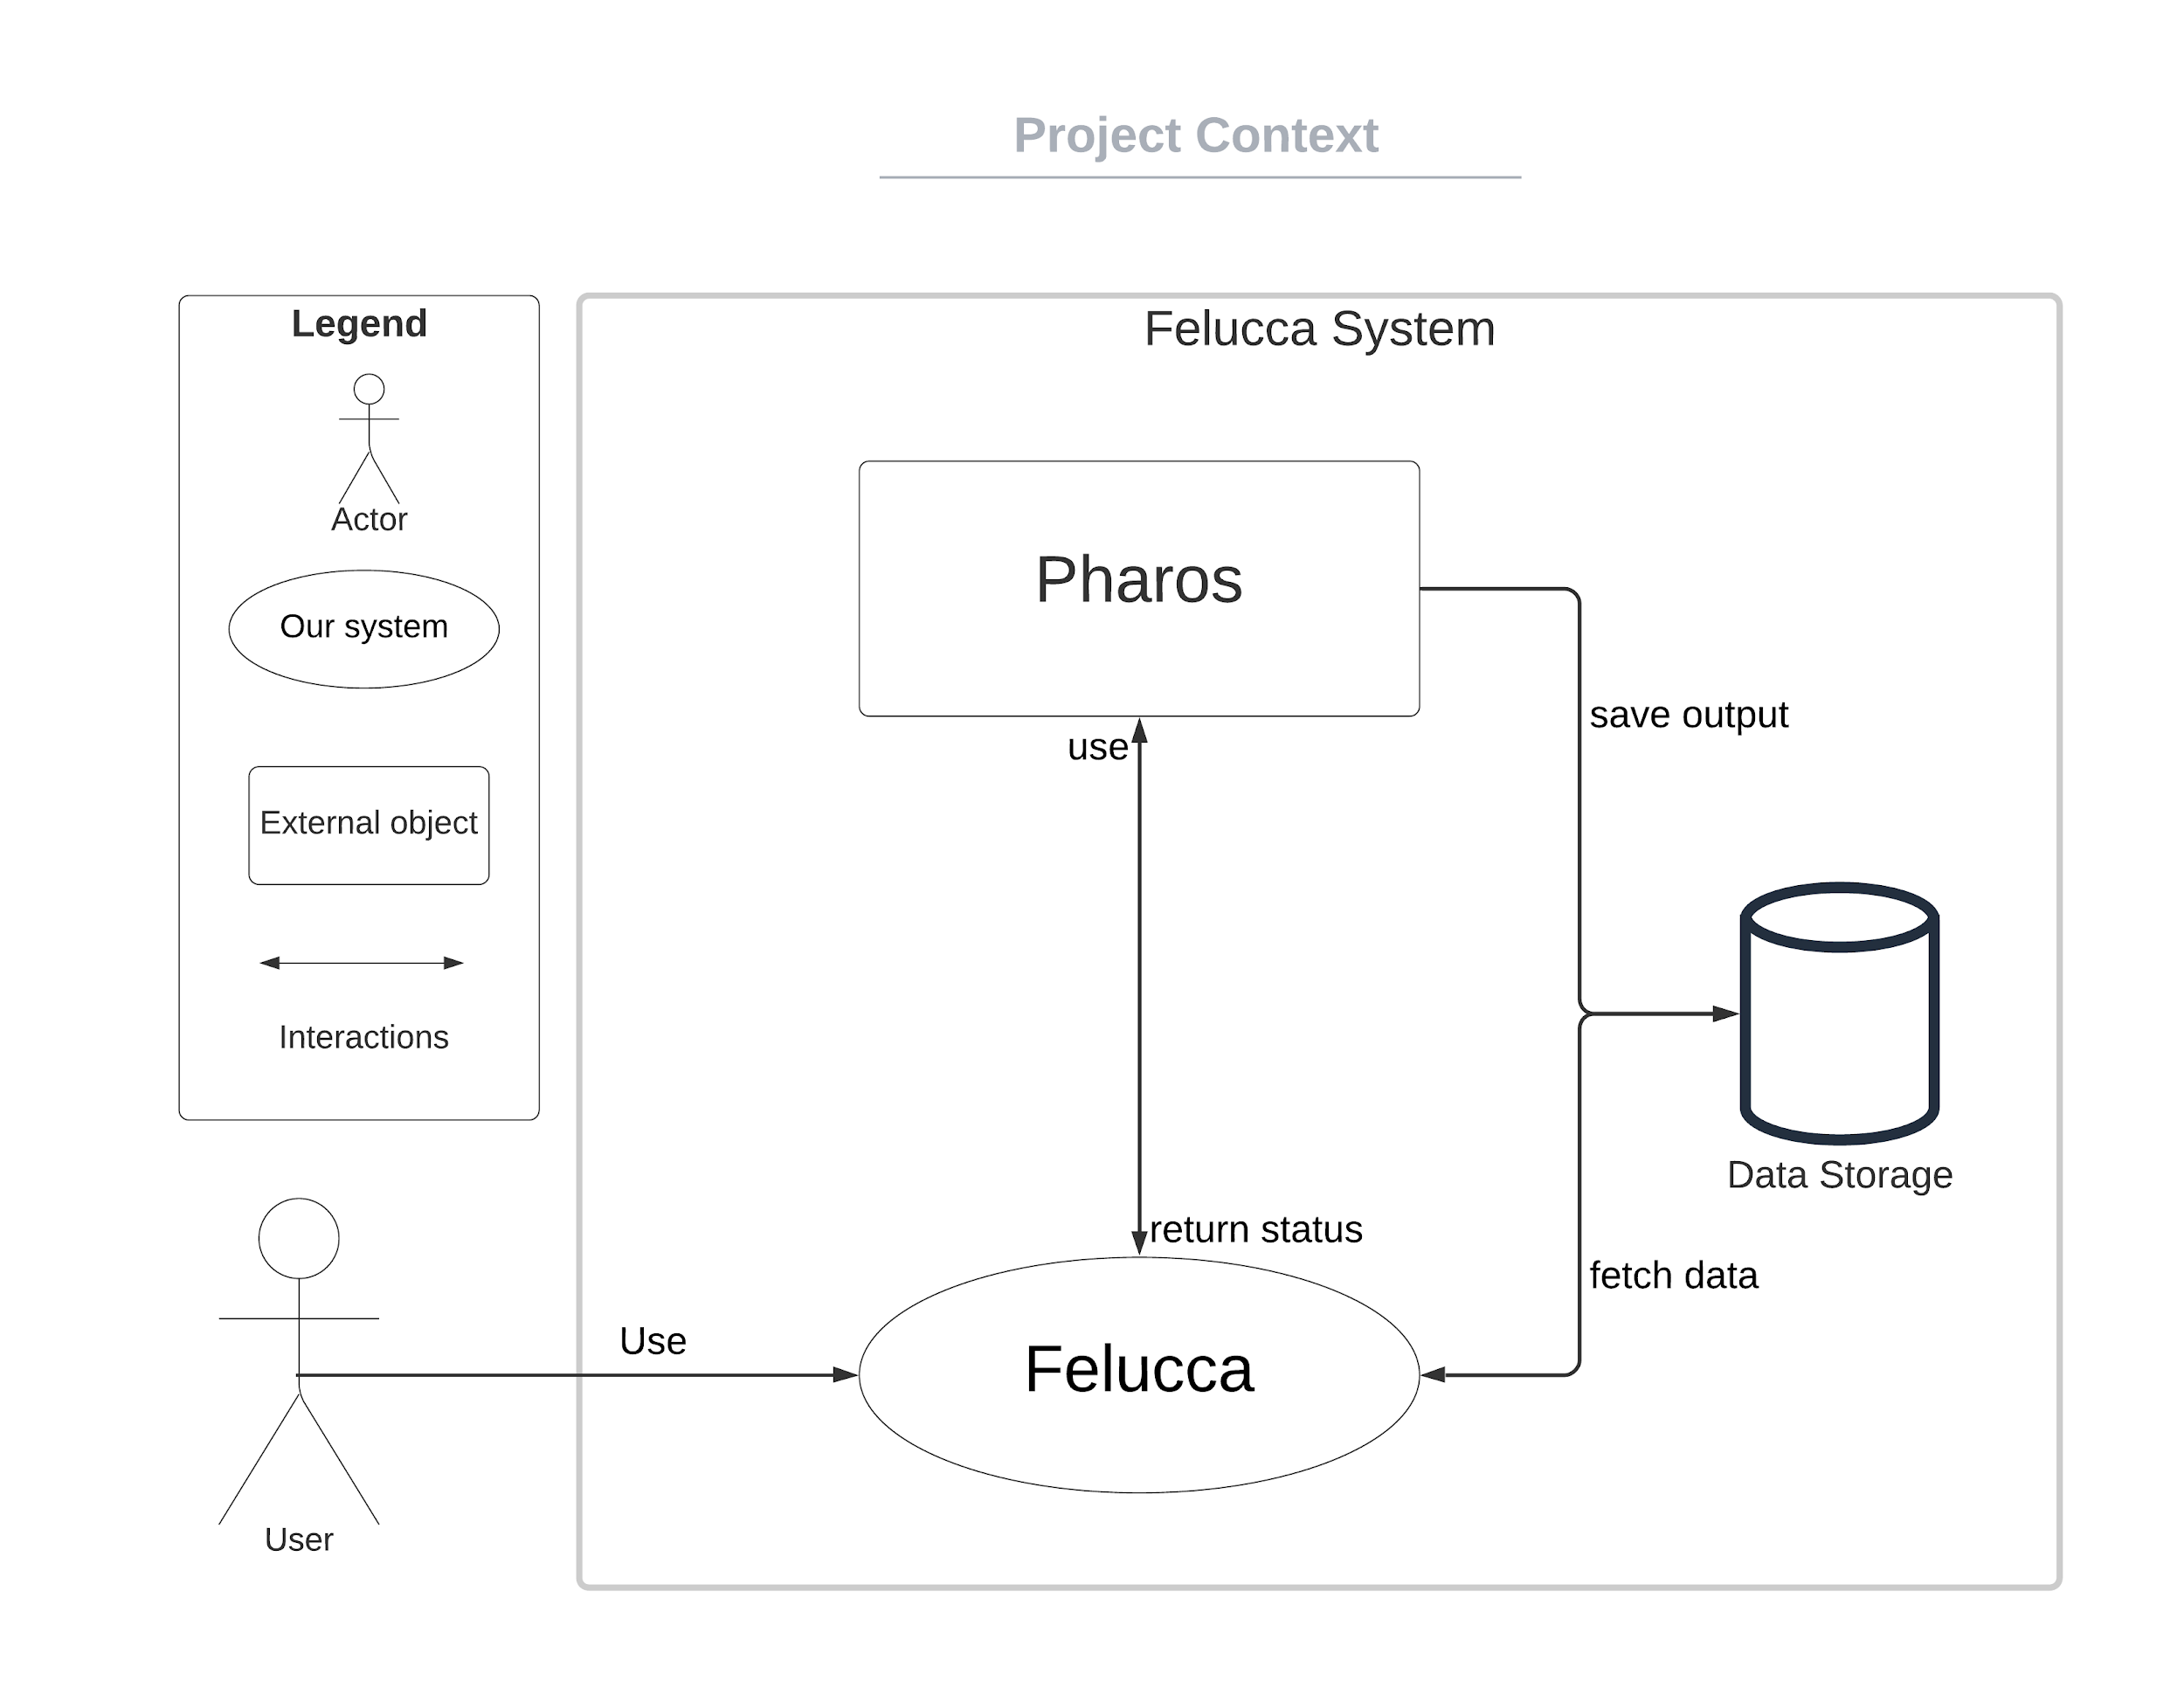
Architecture - Project Context
Notes:
06:31

Slide 18
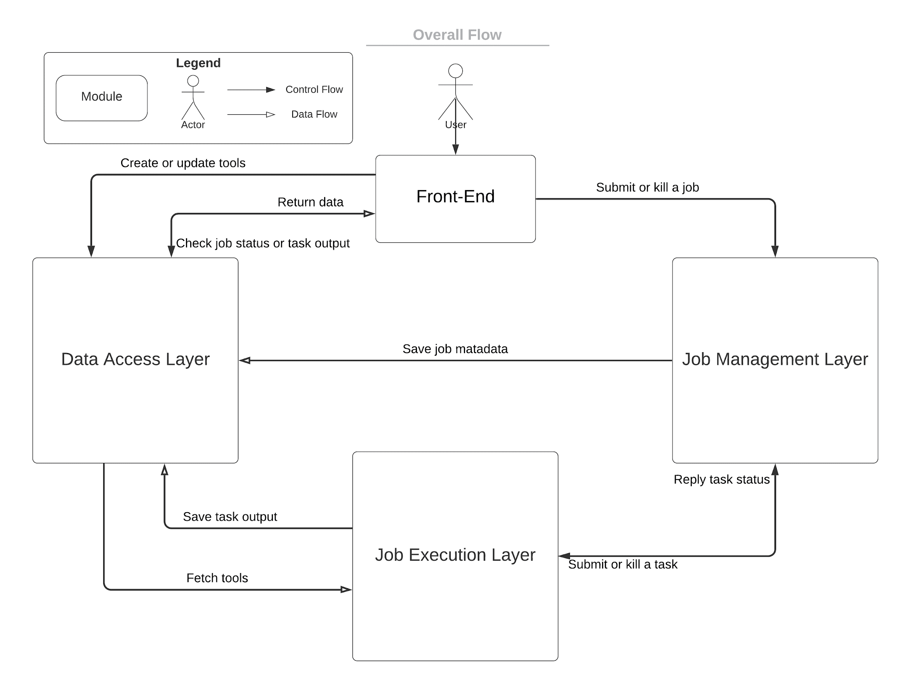
Architecture - Overall Flow
Front-end
Provide user interface and communicate with back-end.
Back-end
Data Access Layer: Provide data storage for tools, job metadata and output.
Job Management Layer: Manage jobs execution logic and submit tasks to Job Execution Layer.
Job Execution Layer: Execute tasks and store outputs.
Notes:
08:36

Slide 19
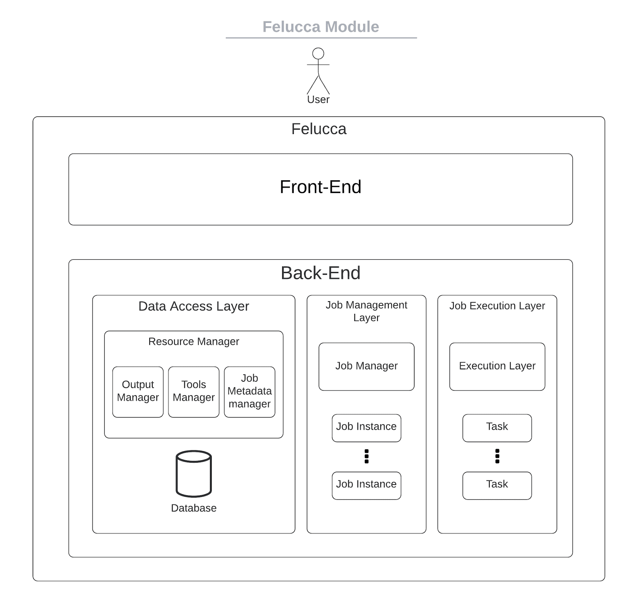
Architecture - Felucca Module
Notes:
07:10

Slide 20
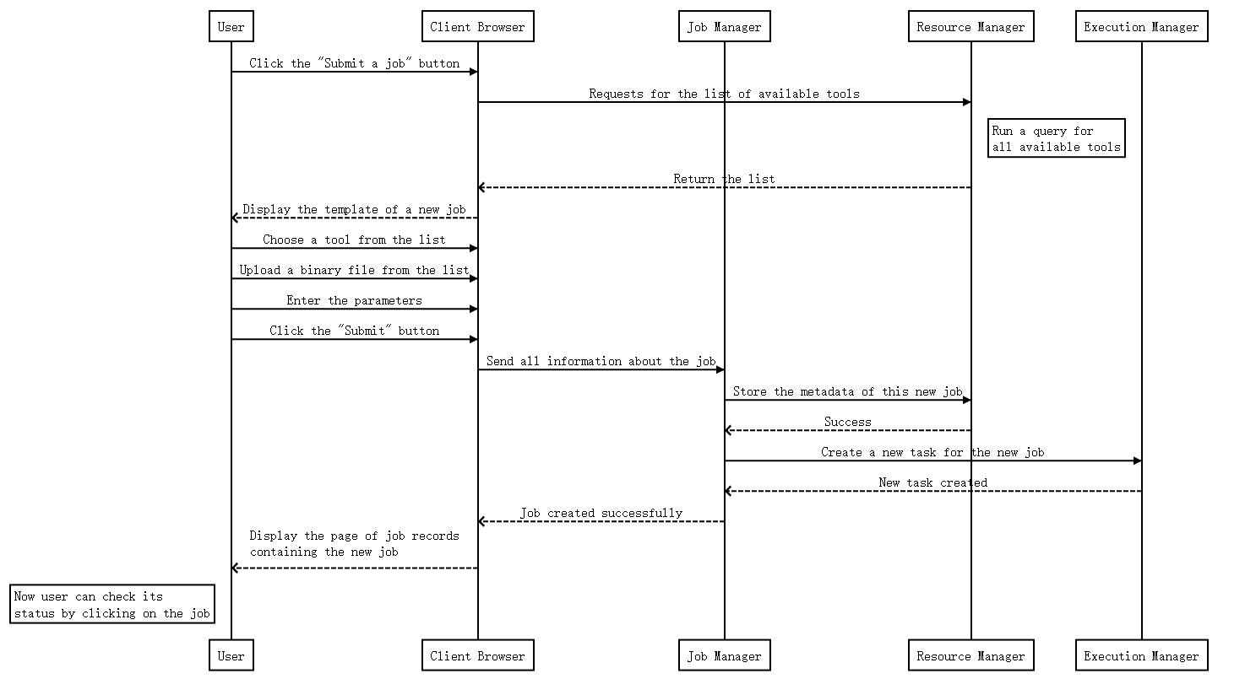
Architecture - Time Sequence Diagram
Notes:
08:04

Slide 21
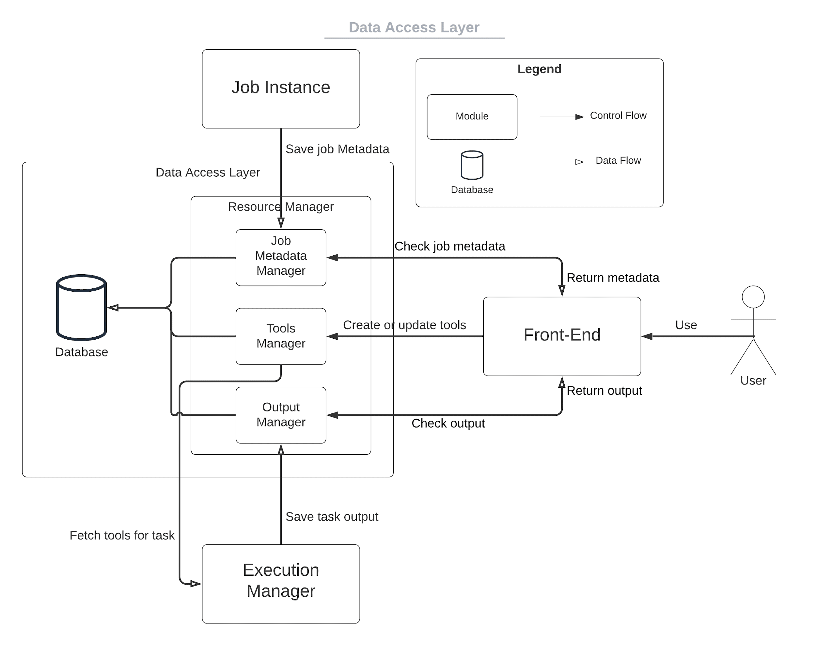
Architecture - Data Access Layer
Resource Manager
Tools Manager: Manage tools update and fetch (both Pharos and customized)
Job Metadata Manager: Manage metadata for each job
Output Manager: Manage outputs from each jobs
Database
Provide reliable storage
Notes:
08:36

Slide 22
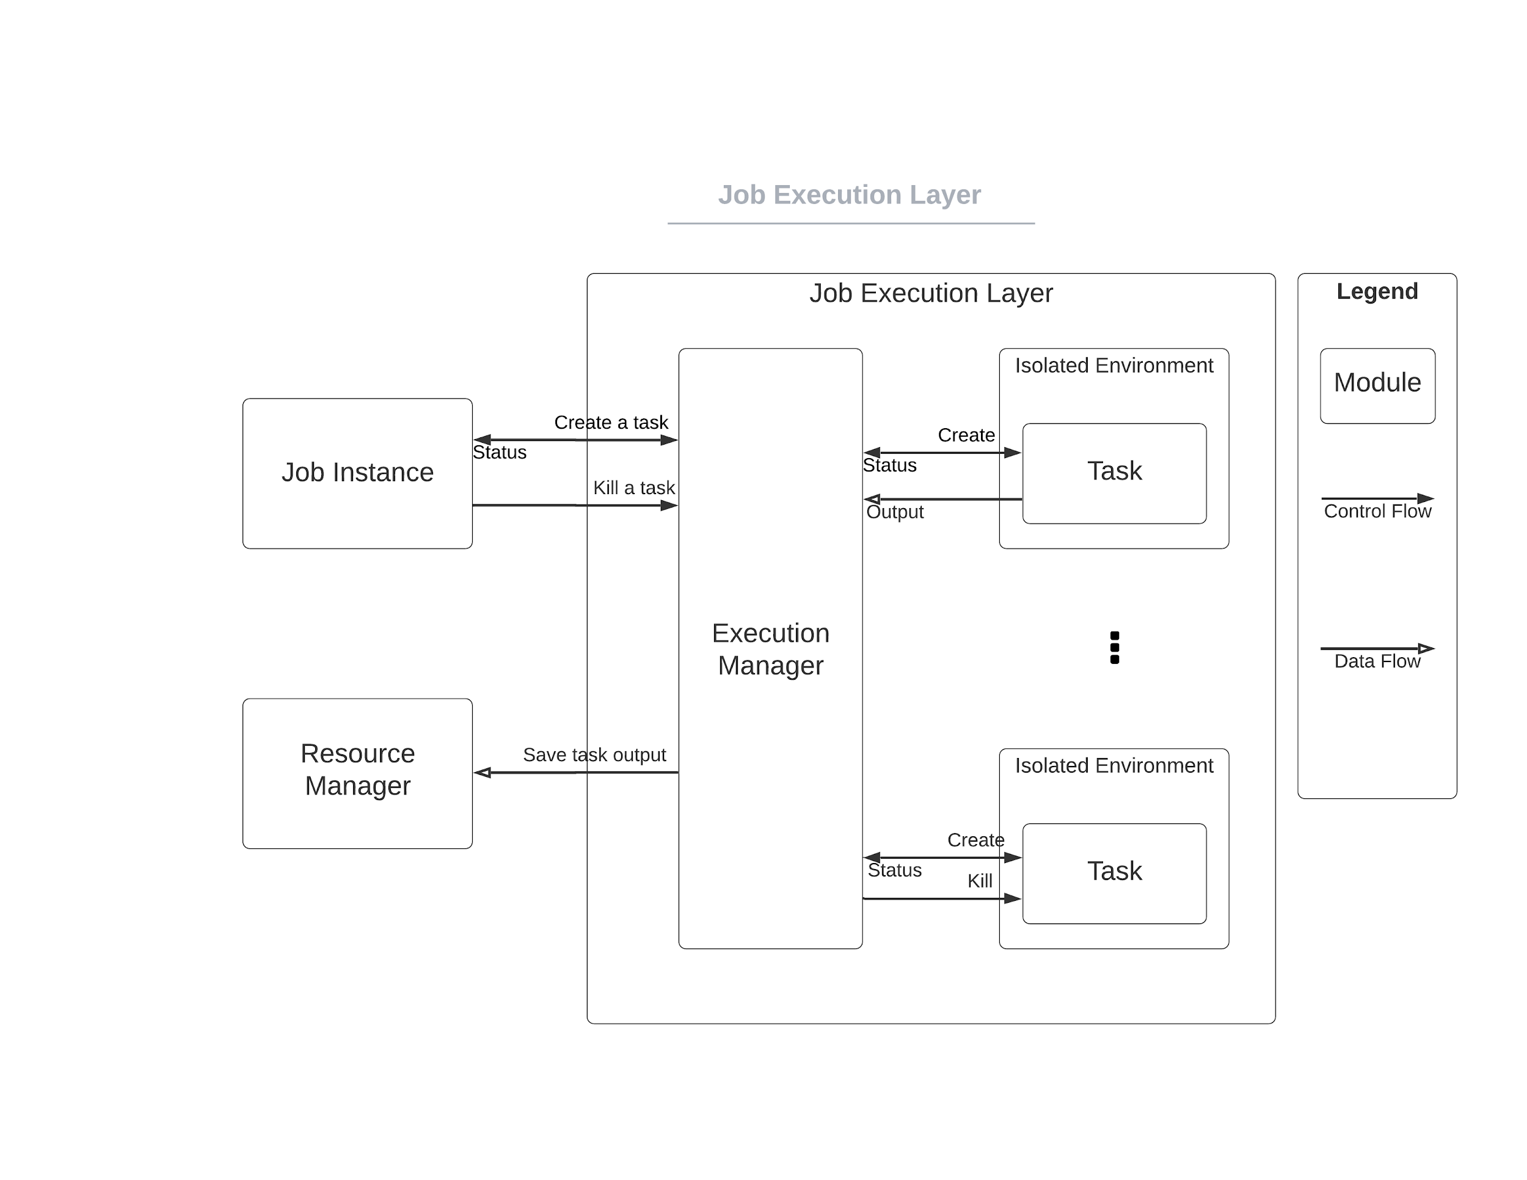
Architecture - Job Execution Layer
Execution Manager
Execution Manager will start tasks according to the request from Job instance. It would update the task status back to job instance and save output to Data Access Layer.
Task
Task are managed by Execution manager and running in an isolated environment.
Notes:
08:36

Slide 23
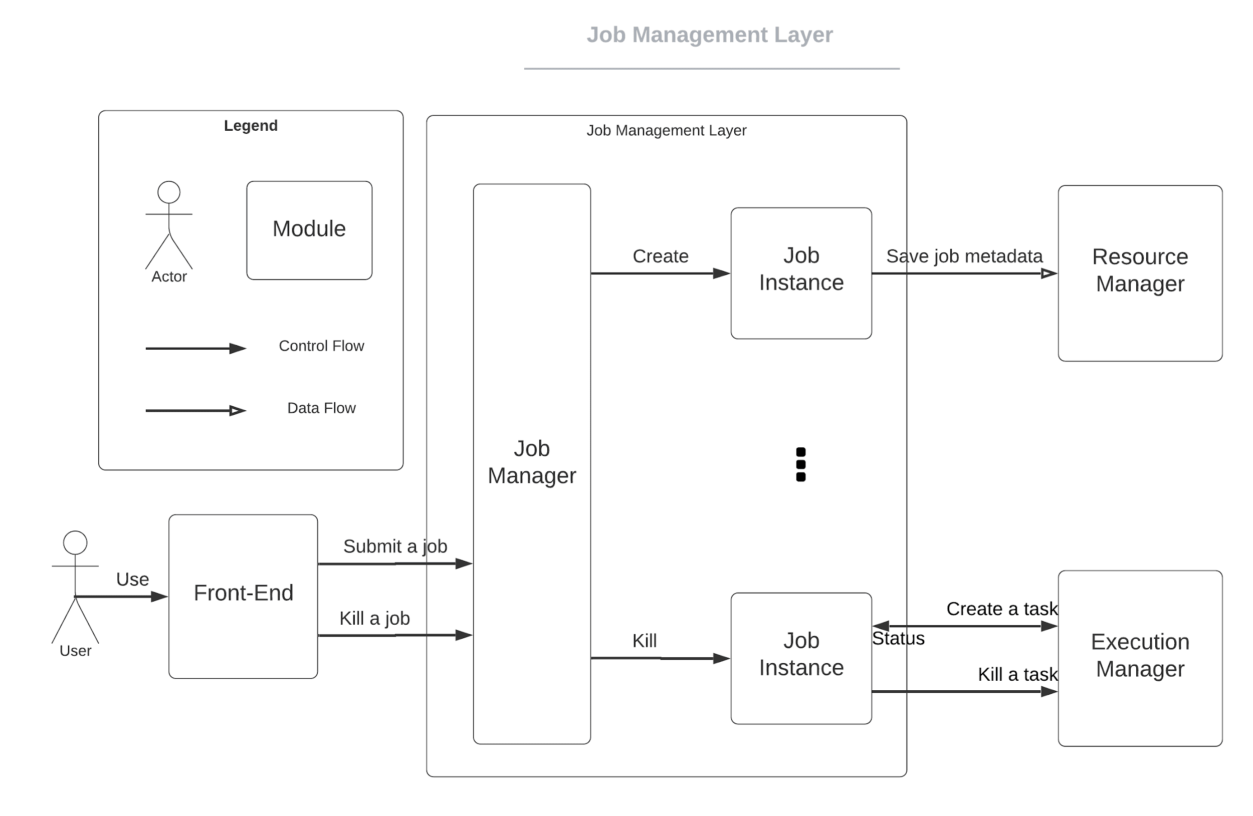
Architecture - Job Management Layer
Job Manager
Manage the Job Instances when receive a job submission or termination message from front-end.
Job Instance
Deal with dependencies in between the tasks and submit tasks to Job Execution Layer.
Notes:
08:36

Slide 24
Technical Stack

Slide 25
Technical Stack - Front-end
Bootstrap
Pros:
Fewer cross-browser bugs
Cons: Require lots of style overrides
AngularJS
Pros:
Component-based architecture
High performance
Cons: Learning difficulty
React
Pros: Saving time while re-using React components
Cons: Lack of documentation
Notes:
We choose the BootStrap + AngularJS, because it can satisfy all our UI requirements, component-based architecture for creating the UI components will be easy to use and maintain, and some of our developers have previous experience on this.

Slide 26
Technical Stack - Back-end
Flask
Pros:
Simple
Lightweight
Minimalist web framework
Cons: Lack of the built-in features
Django
Pros: Full-stack Python web framework
Cons: Modules not needed for lightweight applications
Notes:
Because Flask is lightweight and some of our group members have Flask development experience, we decided to use Flask as our back-end.

Slide 27
Technical Stack - Database
MySQL
Pros:
Relational Database
Open Source and free
Lightweight and fast
Cons: Less efficient when the amount of data increases, inflexible
MongoDB
Pros:
Support large range of data types
Store data in json files, which could be directly processed by Python
Cons: Weak support for complex join queries
Notes:
We choose MongoDB instead of relational databases because it supports flexible data types and provides more intuitive interfaces than SQL.

Slide 28
Technical Stack - Execution Environment
Docker
Pros:
Lightweight
Faster to boot up
Centralized image management
Cons: Isolation level are not as high
Virtual Machine
Pros:
Complete isolation
Full virtualization
Cons: Large overhead
Notes:
Because the isolation provided by Docker Containers are sufficient and users might be sensitive to execution overhead. We decided to use Docker Containers as the execution environments. Moreover, Pharos toolset is well-dockerized, which means managing tools using Docker is preferable for this project.

Slide 29
Project Planning

Slide 30
Project Planning - Overview
Jan
Fab
Mar
Apr
May
Jun
July
Project Start
Project Setup
Requirement
Architecture
Prototype
Complex Req
Optional Req
Meet with client and mentor
Setup GitHub project, write statement of work document
Finalize requirement, write use case document
Design system architecture
Notes:
high level plan, follow the agile the process for each phases
these are phases,

Slide 31
Planning - Methodology
04
Client Requirement
Release
Meeting with client, and finalize the requirement into different use cases
Cut a release to the client and get feedback or new requirement
01
03
Sprint Planning
Development & Testing
Break the use cases in to technique issue, set up a development plan
Code development and QA testing
02
Notes:
utilize it into four steps

Slide 32
Project Planning - Future Sprint
Sprint 5
Sprint 6
Sprint 7
Sprint 8
Sprint 9
Sprint 10
Sprint 11
May 15
May 29
June 12
June 26
July 10
July 24
Aug 7
Prototype
Prototype
Complex Req
Complex Req
Complex Req
Optional Req
Optional Req
Submit Job, Kill Job
Modify Pharos Toolset, Check Log/Output
Create Account, Log in,
Check log, check status,
Multi-user, Kill task
Add Customized tools
Update/Remove Customized Tools,
Notes:
just an example , this may change, depend on client requirement etc. This is a general schedule or example for the future sprint, this may change overtime, due to the change of the requirement or the feedback,or we go beyond or behind the schedule, or the
flexible,

Slide 33
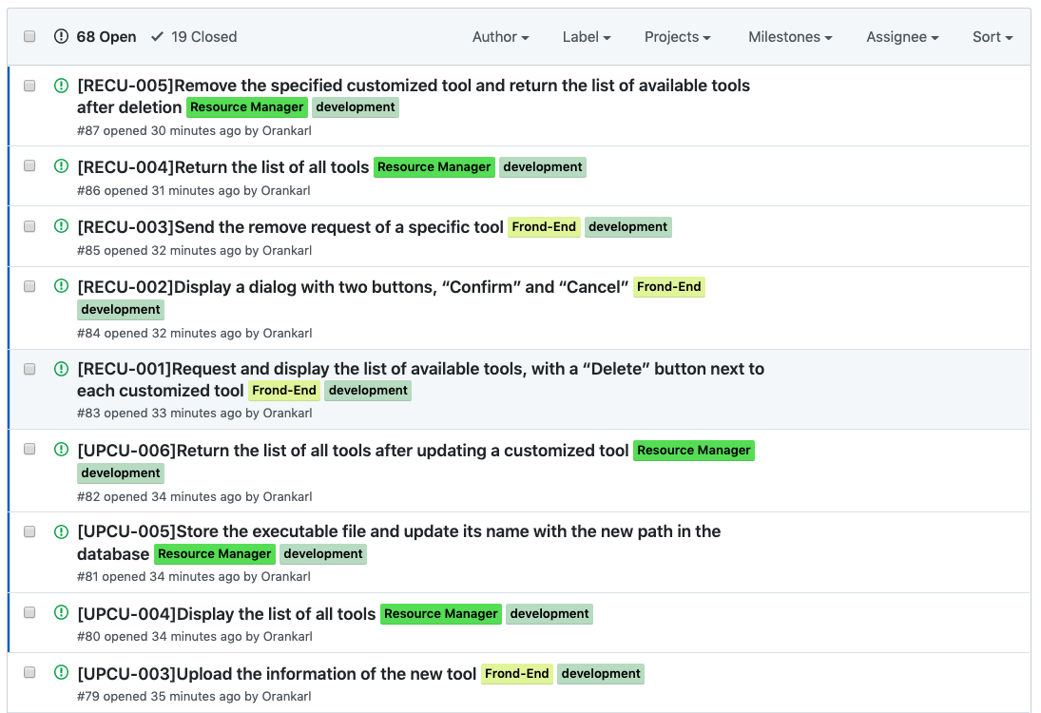
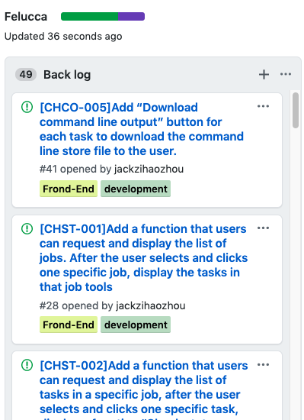
Project Planning - Issue
Break use cases into issues
61 backlog issues
Classified by different labels
https://github.com/MITS-Felucca/Felucca

Slide 34
Project Planning - Labor division
Di Mu
Arrange meetings, manage team progress,
Responsible for front-end development
Sudi Lyu
Mainly focusing on back-end development and QA testing
Zihao Zhou
Mainly focusing on back-end development and QA testing
Guancheng Li
Responsible for database development and maintainess

Slide 35
Project Tracking

Slide 36
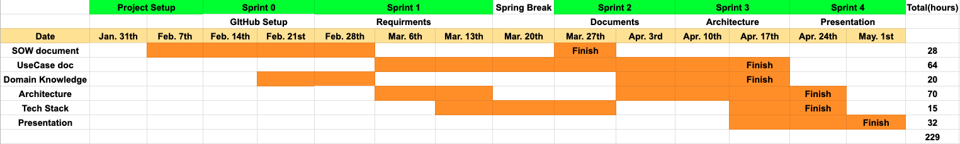
Project Tracking - Team Progress
5 sprints in spring semester - 2 weeks each
Sprint meeting with mentor when a sprint ended
Summarize current sprint status, plan for the next sprint
Notes:
sum total hours.

Slide 37
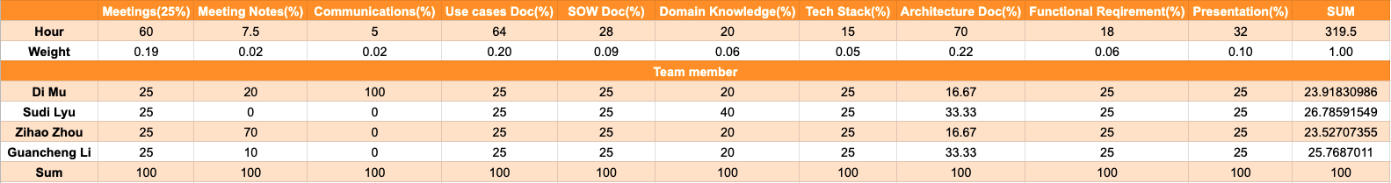
Project Tracking - Metric
Weight for each task
Percentage for participation
Total score
Notes:
should have some explanation here.
total 200
sow 25
sow weight: 25 / 200 = 0.25
each person: 0.25 * 0.25
plus the meeting
complex is different, so weight hight
team choise,

Slide 38
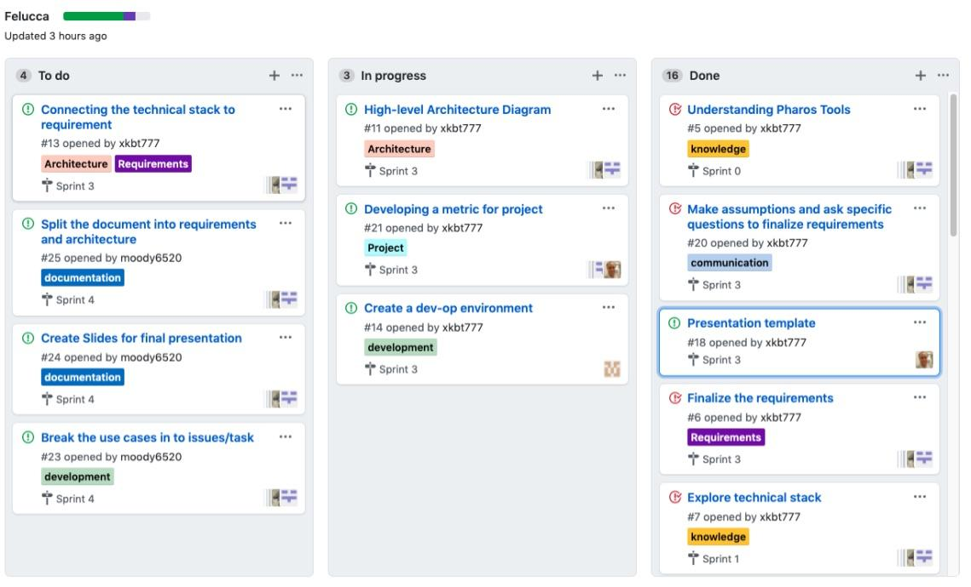
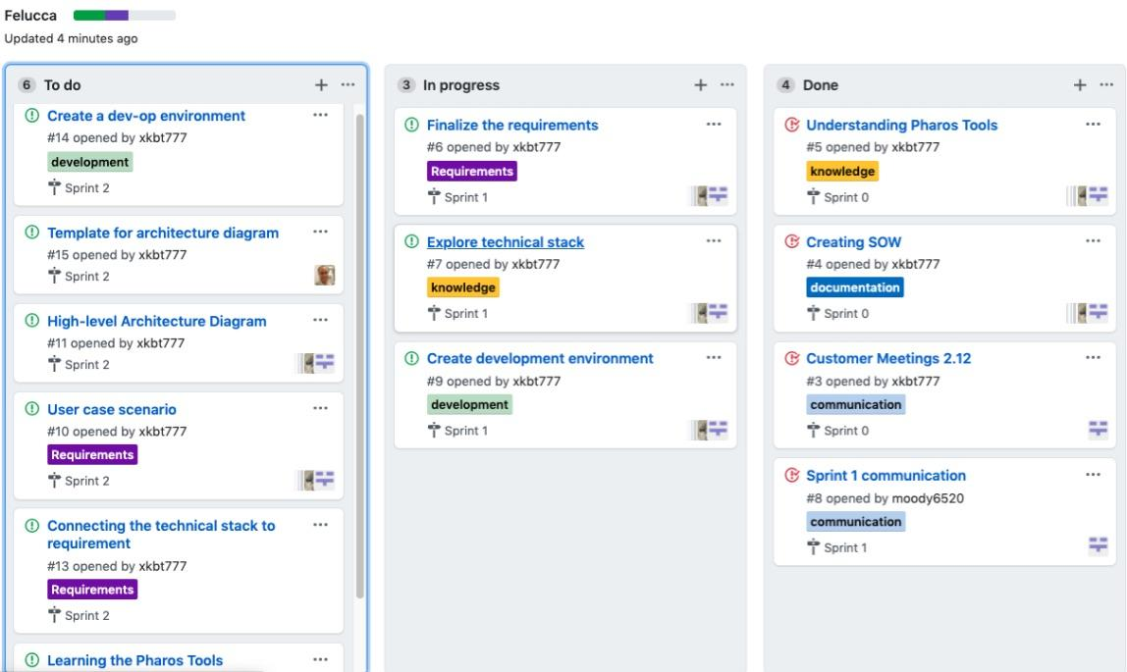
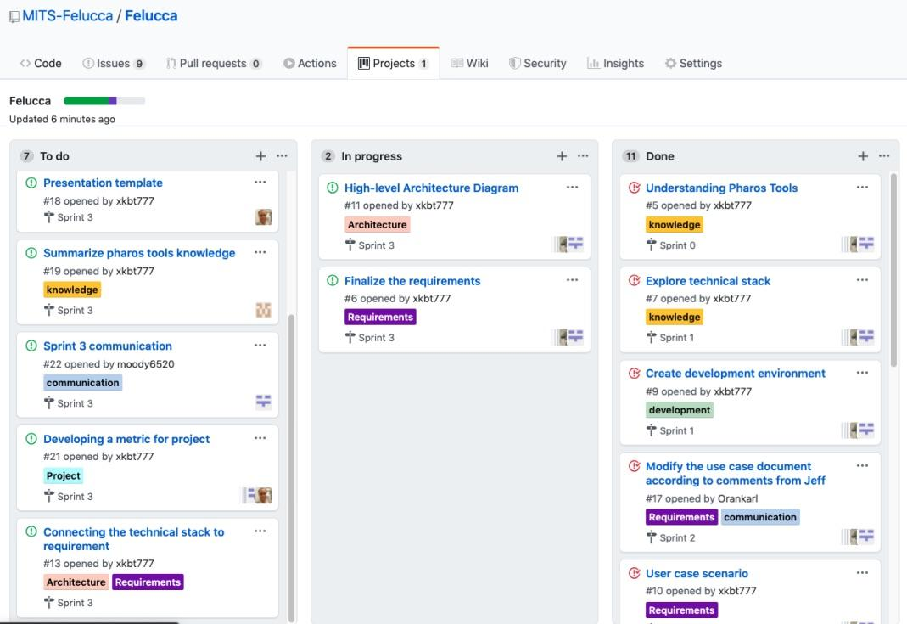
Project Tracking - Kanban Board
Todo, In progress, Done
Labeled
Assignee
Milestone
Notes:
github + url (make it public) https://github.com/MITS-Felucca/Felucca

Slide 39
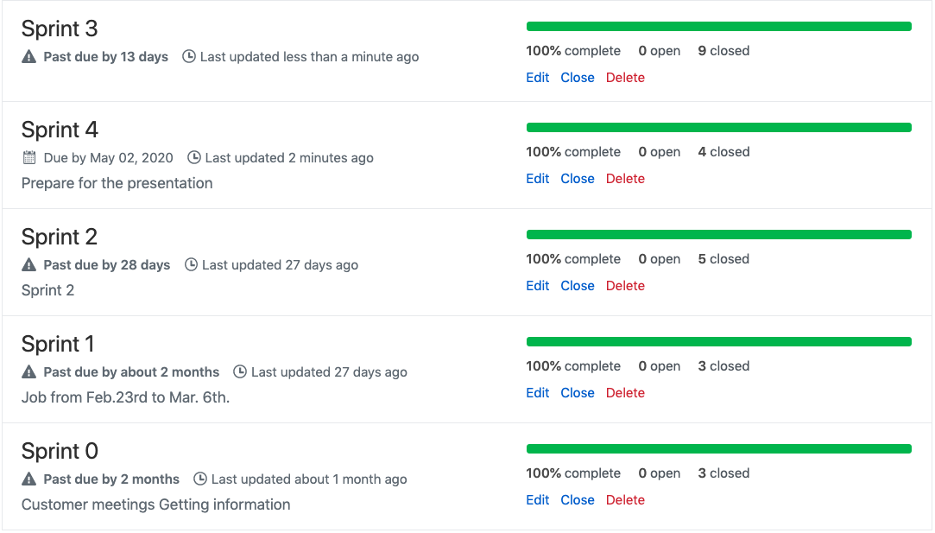
Project Tracking - Milestone
5 sprints
Several issues for each sprint

Slide 40
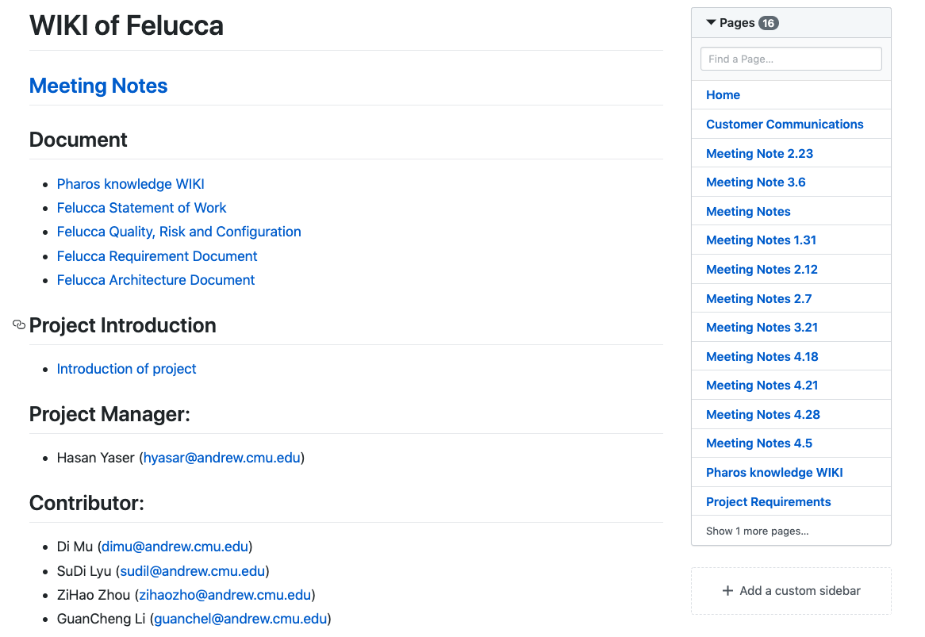
Project Tracking - Wiki
Meeting notes
Documents
Domain knowledge
Questions for client
Notes:
TODO: create a new milestone and all should complete

Slide 41
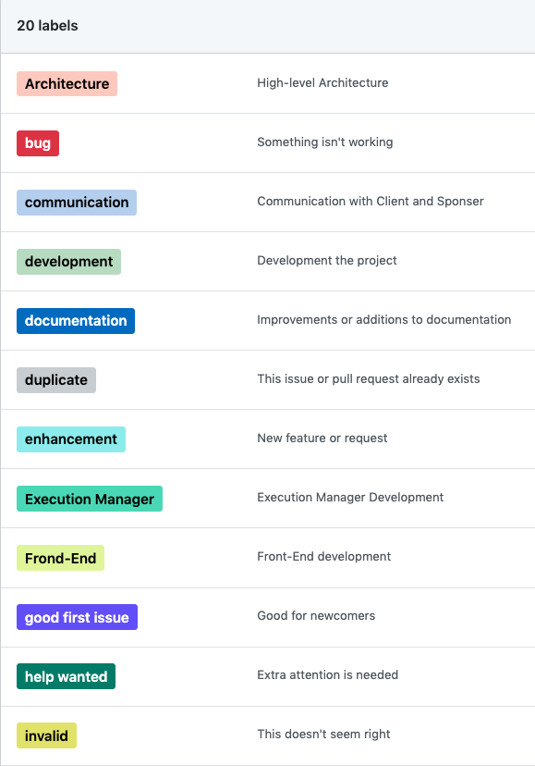
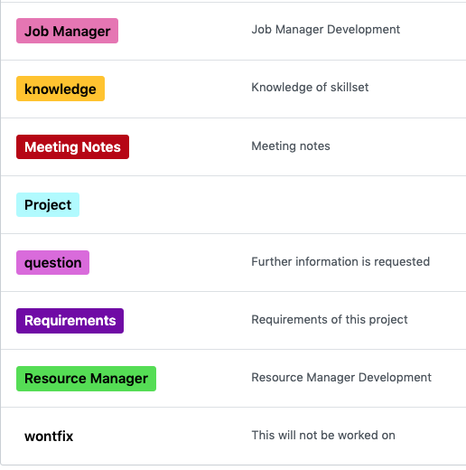
Project Tracking
Labels for each issue
Well-classified

Slide 42
Quality
Management
Notes:
18:35

Slide 43
Quality Management - Quality Attributes
Isolation
Pharos tools might use to analysis malicious code, any damage caused by execution should be contained.
Maintenance
Pharos toolset is a tool set that is evolving, Felucca should support future version of Pharos and easy to maintain.
Availability
Different roles require different connectivity environments, so Felucca should be able to provide full functionality in each environment.
Notes:
19:11

Slide 44
Quality Attribute - Isolation
Isolation QA-1:
Source: Any user
Stimulus: Malicious binary uploaded by user
Artifact: Job Execution Layer
Environment: Normal job execution conditions
Response: Tasks are executed an isolated environment.
Response Measure: Damage inside execution environment is contained

Slide 45
Quality Attribute - Maintenance
Maintenance QA-2:
Source: Developers
Stimulus: Developer update Pharos toolset
Artifact: Tools Manager
Environment: Developer role condition
Response: Felucca decouples with Pharos toolset and provide version check
Response Measure: Felucca could support developers’ update on Pharos

Slide 46
Quality Attribute - Availablity
Availablity QA-3:
Source: Any users
Stimulus: Different roles may demand different environments (online or offline)
Artifact: Back-end
Environment: Normal condition
Response: Felucca supports different modes to adapt specific environments
Response Measure: Felucca is able to provide whole functionality in all environments

Slide 47
Quality Management - Goals
Meet all ‘Must have’ use cases, most of (as least 3 out of 4) ‘Nice to have’ use cases and half of ‘Optional’ use cases.
Meet all quality attribute requirements.
Code conforms to our style guideline (Google style guideline).
Provide user-friendly UI at front-end to ease the pain of complex arguments in Pharos toolset.
No active defect.
Notes:
20:05

Slide 48
Quality Management - Tests
Testing Strategy | Technique | Tool | When to perform
Unit Test | Intra-module testing | Unittest, Pytest | Any code update
Integration Test | Boundary testing, combinatorial testing, mock module | Python stubs | Merge with development branch
System Test | Requirement based testing | Manual | Module updating, Merge with master branch
Usability Test | Peer review | Manual | Front-end delivery
Acceptance Test | Client review | Manual | After delivery
Notes:
20:40

Slide 49
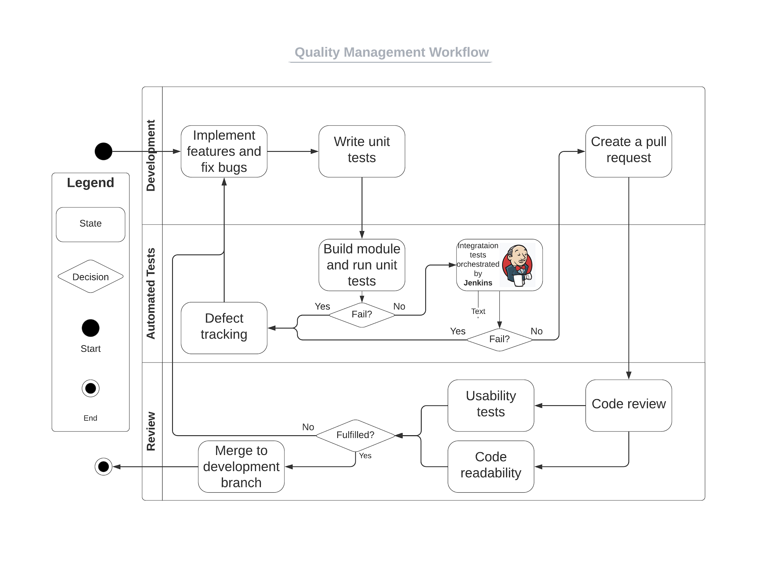
Quality Management - Workflow
Notes:
how we act automated tests
Jenkins platform
21:40

Slide 50
Quality Management - Criteria
Unit Tests
Code coverage beyond 80%
Pass all new-written and old tests
Integration Tests
API-based, Written by other developers
System Tests
Requirement-based, cover 100% non-functional requirements
Usablity Tests
Group Review, Peer Review, Client verification
Code Review
Code Readability
Group Review deadline
Notes:
how many percentage
21:59

Slide 51
Quality Management - Defect Tracking
Defect
Defects are discovered in unit or Integration Tests, which caused by insufficient API design or architecture inconsistency.
Defect Reviewing
All discovering defects are reviewed in next sprint meeting to figure out if it is solvable, if it is worth solving, how many work(hours) we need to fix it and the priority of this defect.
All solvable and worth solving defects are marked as “active” and issues are created.
Important defects will be reported to client.
Defect fixing
All “active” defects would be fixed based on its priority.
Notes:
22:51

Slide 52
Risk
Management

Slide 53
Risk Management - Process
Step1
Step2
Step3
Step4
Step5
Identify risks
Report to all members
Discuss in next meeting
Execute mitigation plans
Monitor risk
Notes:
23:25

Slide 54
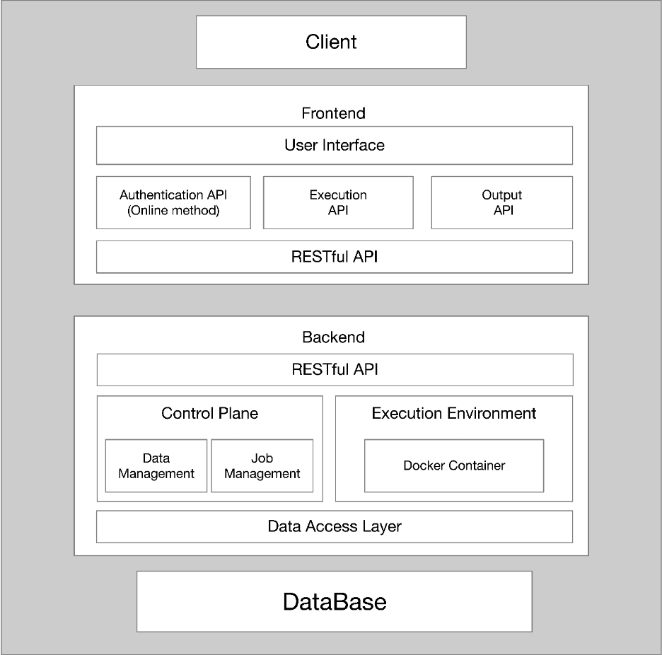
Risk Management - Process Example
Step1
Identify risks: No allocator or job manager to allocate tasks
Notes:
23:51

Slide 55
Risk Management - Process Example
Step1
Step2
Report to all members

Slide 56
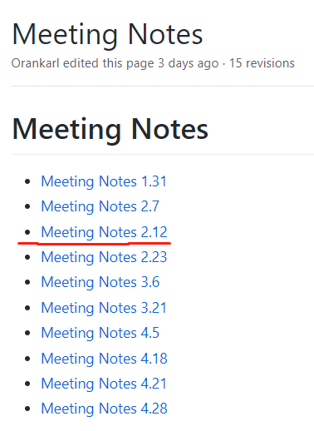
Risk Management - Process Example
Step1
Step2
Step3
Discuss in next meeting

Slide 57
Risk Management - Process
Step1
Step2
Step3
Step4
Execute mitigation plans
Separate Job functions from Resource Manager and establish a Job Manager

Slide 58
Risk Management - Process Example
Step1
Step2
Step3
Step4
Step5
Identify risks
Report to all members
Discuss in next meeting
Execute mitigation plans
Monitor risk
Notes:
24:31

Slide 59
Risk Management - List Example
Risk | Part | Impact | Mitigation | Status
No allocator to allocate job to execute | Basic Architecture | High | Add a job manger in our basic architecture | Closed
Felucca may be inconsistent with Phraos tool core | Code | High | Dig into API and the logistic of Pharos core | Ongoing
All team members do not have MongoDB development experience | Background | Low | Learning MongoDB while developing | Ongoing
Lack of an efficient way to communicate with client with a strict schedule | Teamwork | Medium | Refine our major problem to several concrete and detailed questions, and make sure the answers of these questions can solve our current problem | Ongoing
Notes:
兼容性
学习曲线 risk
25:15

Slide 60
Configuration Management
Notes:
Add environment, script, same for everybody,

Slide 61

Configuration Management
Code Management:
Managed through GitHub
Our plan is:
Each function developed on dedicated function branches
Merge to master development branch after done
Open a maintenance branch
github.com
Notes:
25: 31

Slide 62
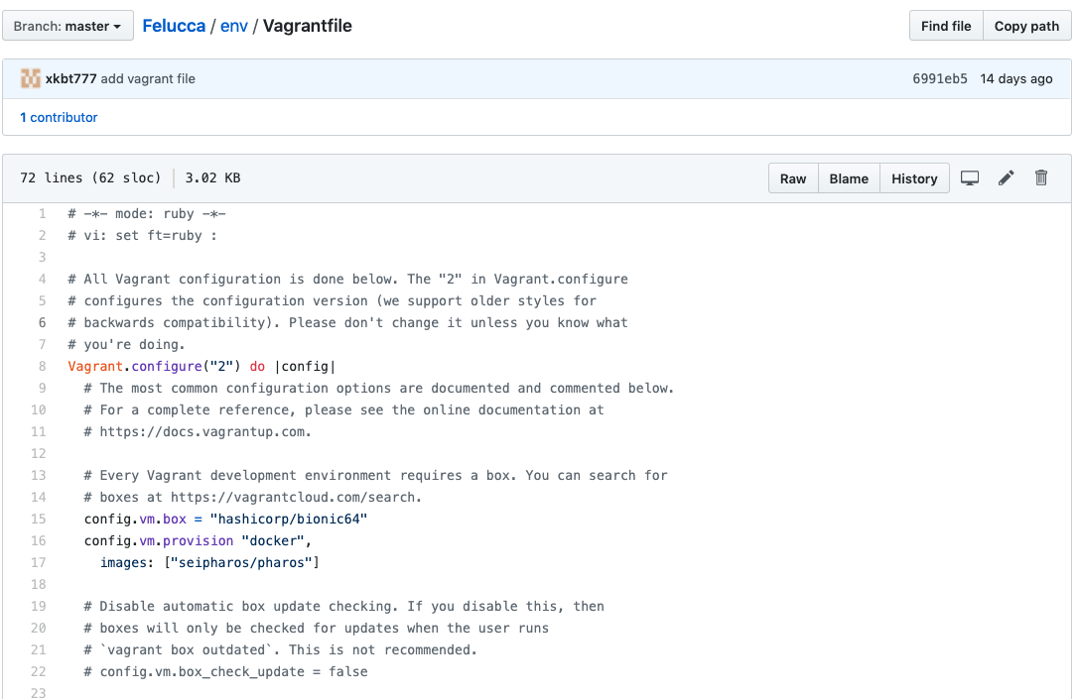
Configuration Management
Environment Management: managed by Vagrant file, stored in GitHub
Notes:
25: 31 keep in the github.

Slide 63
Configuration Management
Document Management:
Keep a log for each document artifact.
The log is updated with version number, date of change, description of change, editor and reviewer. Each time a modification is made to a document log.
Notes:
Describe what the control center mean in several miniutes at this slide and it is actually beyond a dashboard.
26:00

Slide 64
Part of Log of Different Documents
Architecture Document
Version | Date | Change | Updated by | Reviewed by
0.4 | Apr 12nd, 2020 | Add time sequence diagram | Guancheng Li | Jeffrey
0.5 | Apr 24th, 2020 | Update detailed flow digram and time sequence diagram to unify the glossary | Sudi Lyu, Guancheng Li | Hasan
Statement of Work
Version | Date | Change | Updated by | Reviewed by
0.6 | Apr 6th, 2020 | Add deployment mode | Sudi Lyu Di Mu
1.0 | May 1st, 2020 | Re-organize contents | Guancheng Li Di Mu
Requirement Document
Version | Date | Change | Updated by | Reviewed by
0.1 | Feb 7th, 2020 | Structure of the document | Sudi Lyu
0.2 | Feb 10th, 2020 | Scope of work | Guancheng Li
Notes:
26:15

Slide 65
Reflection
Notes:
use zoom as communications,

Slide 66
Reflection
Learn the way to code as an organization
Agile, scrum procedure
Learn technical details
Some of us were not familiar with the framework we use before
Make use case too soon without digging into the domain knowledge
This leads to our use case is a little high-level and not detailed enough

Slide 67
Reflection (cont’d)
Not go into system architecture too soon
Lack of knowledge about the requirement
Find an efficient way to communicate with others is very important
We should have a general expectation about what we want before we pose a question
How to build up and work as a team
Notes:
27:40 add more here
agile, scrum,
leaen tool,
learn some language how to build up a team
how to work as a team.
how to coummincate
how to build a system

Slide 68
Thank you
Team BugHunter
Di Mu
Sudi Lyu
Zihao Zhou
Guancheng Li
Notes:
Thank you and team name

Slide 69
Q & A
Team BugHunter
Di Mu
Sudi Lyu
Zihao Zhou
Guancheng Li
Notes:
THank, team names

Slide 70
Backup

Slide 71
Technical Constraints
TC-1: Binary files should not be stored on the server. (Delete after execution)
TC-2: Docker should be installed on the machine where Felucca runs on.
TC-3: Results of finished jobs must be tracked and stored in persistent storage.
TC-4: Felucca should work without Internet access. (local server)
TC-5: Felucca must work with the Pharos Toolset and won’t be affected after updates of the Pharos Toolset.

